Slide 1
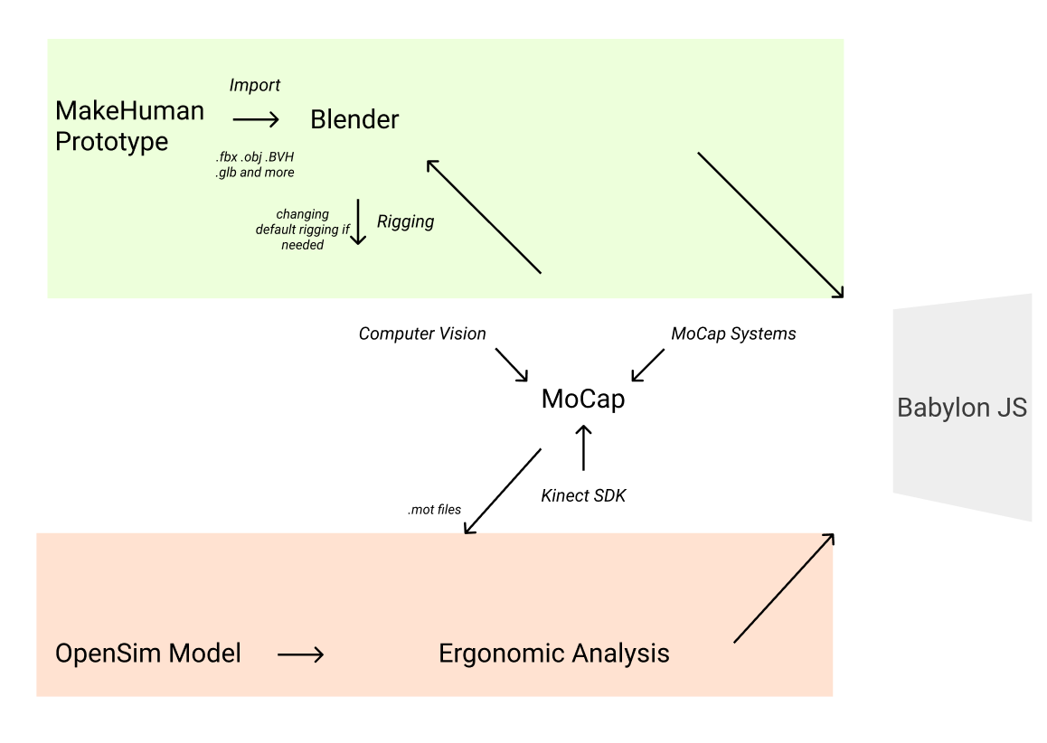
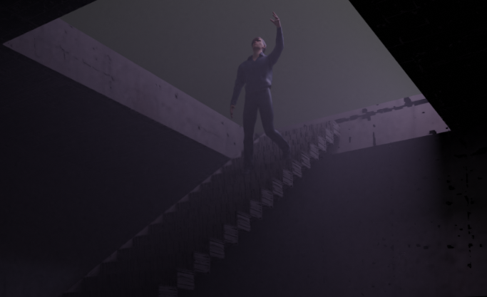
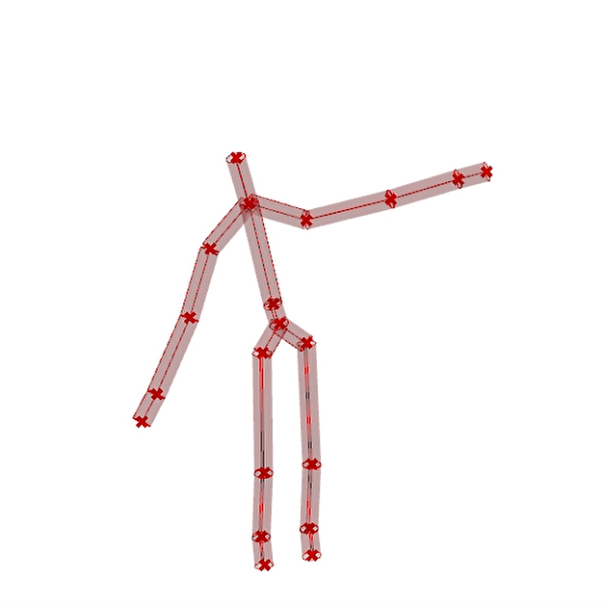
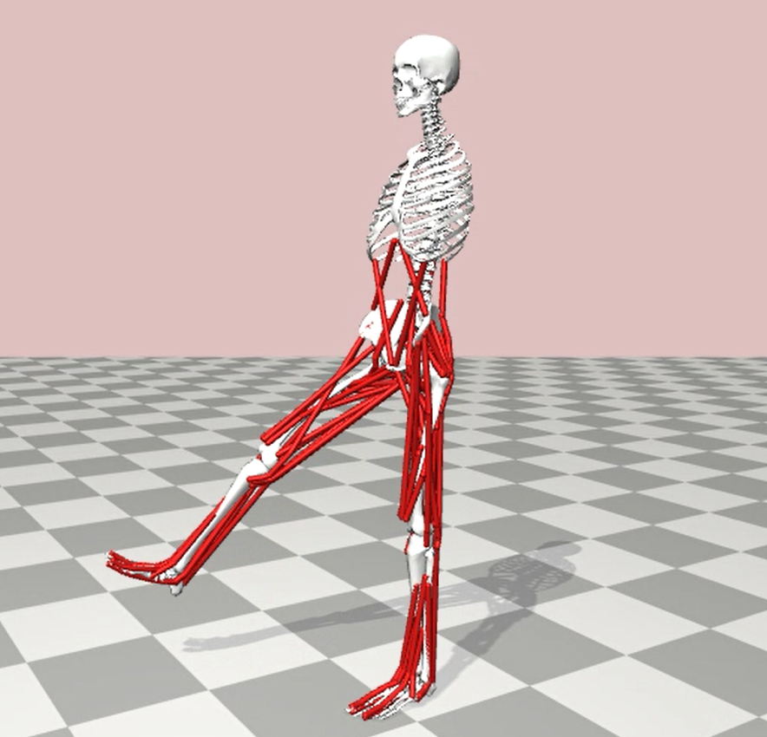

Pavel Popov
Politecnico di Milano
Digital Human Modeling
Human Operator Modeling
Introduction
For some scenes needed to represent processes connected to a workflow in VR or AR environments, it is needed to create a model of a human body. There are several ways to develop the model focusing on different parameters needed for a scene.
Workflow
Results
The workflow allows user to process with step by step creation of a human operator focusing on two different approaches – traditional body surface and more complex musculoskeletal one.
Conclusion
The workflow shows two ways of creation, describes pro and cons of each approach and provide suggestions for further development of a topic

